Slide 1
Supporting Kinship Caregivers in Ohio –
CASA Presentations 2023
ODJFS – Office of Families and Children: Children Services Training and Development Team​​
Notes:
First let me start by introducing myself. My name is Tara Shook, I am a member of the Children Services Training and Development team at ODJFS in the Office of Families and Children. I have been with ODJFS for 17 years in various capacities, including adoption policy, ICPC, foster care licensing and substitute care policy. Prior to my time here, I was at Franklin County Children Services for 7 years where I was an ongoing caseworker in a medically fragile baby unit and a home study assessor and trainer for preservice classes.
As I hope you are aware, our office has made a concerted effort over the last several years to support kinship caregivers in more meaningful and long-term ways. I’m going to go over a few of those in our time together today.

Slide 2
Agenda
Kinship Support Program (KSP)
Kinship Caregiver Program (KCP)
Kinship Permanency Incentive Program (KPIP)
Kinship Supports Intervention (KSI)
Ohio Kinship And Adoption Navigator Program (OhioKAN)
Kinship Guardianship Assistance Program (KGAP)
Q & A
Notes:
Today we’re going to talk about different programs available through our office to support kinship caregivers. Some are new, some are not

Slide 3
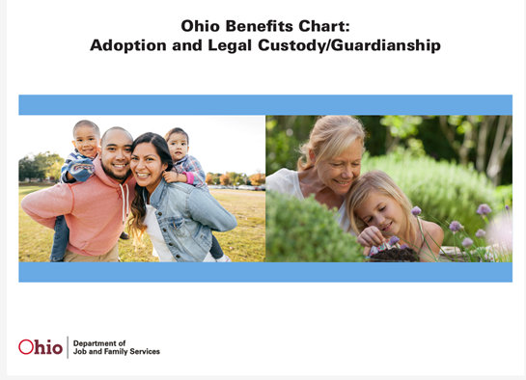
JFS 08072
JFS 08073
All are available
on Forms Central
www.odjfs.state.oh.us/forms/
JFS 08145
3
Notes:
Many of these programs are described in three new publications. I included hard copies in your packets today but they are also available on forms central on emanuals. These are extremely useful tools you can use to discuss kinship programs with the caregivers you work with.
The JFS 8072 is the ODJFS Programs supporting Kinship Caregivers and that packet describes each of the different programs we’re discussing today, along with their eligibility criteria and application requirements.
The JFS 8073 Caregiver Permanency Options brochure discusses the programs in relationship to establishing permanency for the kids under the care of kinship caregivers.
The 8145 is the Benefits Chart- This is an easy to read chart of the differences between adoption, legal custody, and legal custody with KGAP.

Slide 4
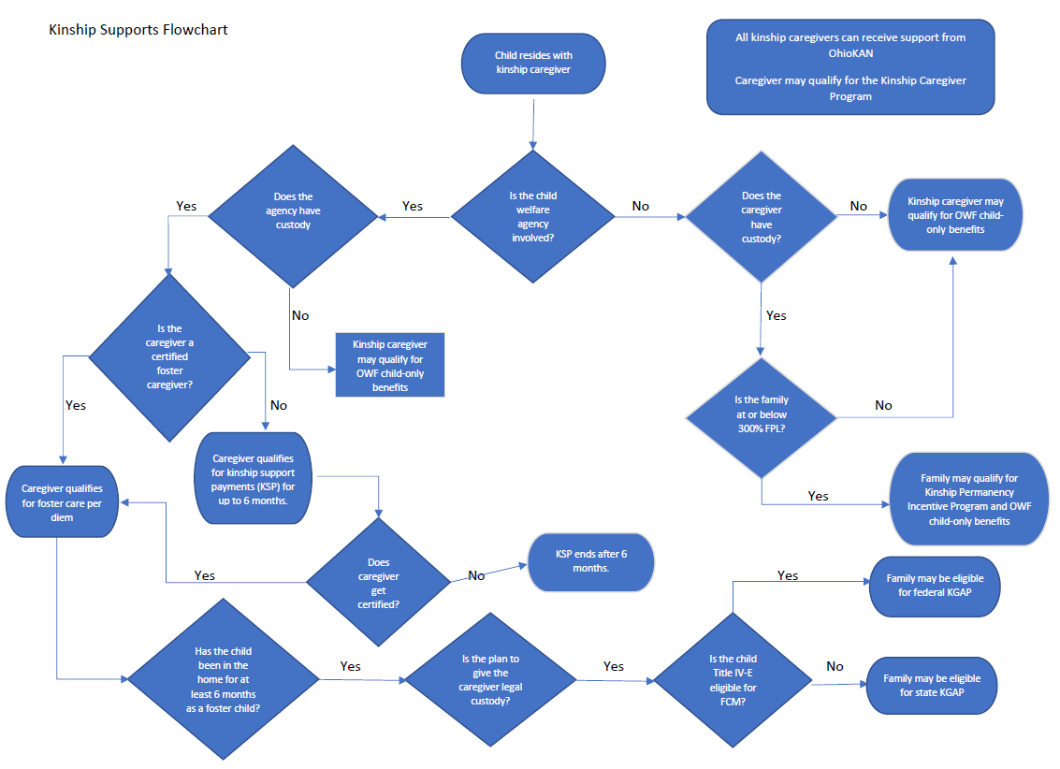
4
Notes:
You also have a handout of this flowchart as well.
Before we get started going over the programs, I wanted to share this high level flowchart that provides a good visual of the different kinship support programs in Ohio. The chart has two main pathways – one where a children services agency is involved and the other where they are not. All of the programs we will talk about today are reflected in this flowchart
You will also note that it includes the Ohio Works First – Child Only program administered through the local county dept of job and family services. While we will not be discussing this program today, information on it is detailed in new Kinship Caregiver forms that were just mentioned.

Slide 5
Kinship Support Program (KSP)
Daily payment per youth
PCSA/Title IV-E agency has custody
Approved kinship home assessment
Automatic payment, no application process
Received for up to 6 months
Notes:
We will start with the Kinship Support Program or KSP. KSP began in December 2020 and provides financial payments to kinship caregivers when a youth is in the custody of a PCSA or Title IV-E agency.
The daily payment is based on Ohio’s current OWF Child Only Cash Assistance benefit for a 1 child household. Currently that rate is $10.80 a day.
Due to this fact, many wonder why the program was created. The kinship support program has 3 advantages over the OWF Child Only benefit:
The kin caregiver does not have to apply for the KSP payment, it is automatically issued through the Ohio SACWIS system once the kinship assessment is approved and the child is placed.
One of the eligibility requirements for OWF Child Only is that non-related kin have to hold legal custody. Therefore, if an agency has custody, non-related kin would not be eligible for OWF child only. They are eligible for this KSP payment.
Unlike the OWF program, the rate paid per child does not decrease for kin caregivers caring for sibling groups. For each child placed with the kin caregiver, the caregiver receives $10.80 a day.
As you can see eligibility for the program is pretty straight-forward. Payments are received for up to 6 months, or until the child is no longer placed, or until the caregiver becomes a certified foster parent.
The goal of the program is to provide compensation to kinship caregivers upon placement of the child into their home. The timeframe allows the caregiver to complete the foster care home study process if they choose to do so. Then, once certified, the child will become a foster care placement and the caregiver will receive the full per diem.
In a few minutes we’ll talk about the kinship guardianship assistance program or KGAP and I’ll show you why certifying these kin as foster parents becomes so important.

Slide 6
Kinship Permanency Incentive Program (KPIP)
8 payments every six months
Income below 300% federal poverty level
Must have legal custody
Approved kinship assessment
Apply through local PCSA
Cannot receive KPIP and KGAP for same youth
Notes:
The Kinship Permanency Incentive Program (KPIP) remains an option for kinship caregivers in Ohio.
KPIP provides periodic financial support, every 6 months, for children in the legal custody of kin. The program is designed to help promote permanency for youth in kinship caregiver arrangements by helping to cover some of the costs of their care. The initial payment is $525 and each additional payment (up to 8 total payments) is $300. These amounts are subject to change each year, but they have not changed in the past several years.
The caregivers’ income must not exceed 300% of the federal poverty level. This amount is published by our office each year in the spring.
In order to be eligible the kinship caregiver must have legal custody and there must be an approved kinship home assessment by the local PCSA, however the PCSA does NOT have to be involved with the family on an open case. This could be an informal arrangement done outside the children services umbrella. The PCSA will then come and complete a kinship home assessment after the fact.
To apply, eligible kinship caregivers need to fill out an application at their local public children service agency.
Families receiving KGAP will not be eligible to also receive KPIP

Slide 7
Kinship Caregiver Program (KCP)
Access through local CDJFS
Funded by PRC
Kinship caregiver - relative by blood or adoption, or legal custodian or guardian of the child.
Childcare assistance: 200% of federal poverty level, includes income of caregiver
Stabilization Services: 200% of federal poverty level, includes only the child
Ex. One time purchase of a bed for the child placed with the caregiver
Notes:
The kinship caregiver program was established a few years ago and is run by each county department of job and family services, it is funded by prevention, retention and contingency PRC funds through the Office of Family Assistance here at ODJFS.
For KCP purposes, a kinship caregiver is a relative by blood or adoption, or a legal custodian or guardian of the child.
KCP includes two supports, child care assistance and stabilization services. Child care assistance is based on income and the caregiver and child have to be below 200% of the federal poverty level. The caregiver also has to be employed or in training to prepare for employment.
For stabilization services, the child alone has to be below 200% of the federal poverty level.
This program is run independently of the other kinship programs and doesn't impact caregiver's eligibility for other supports.

Slide 8
Kinship Supports Intervention (KSI)
Includes relative and non-relative kin involved with children services
Helps prepare for their new role as kinship caregivers
Kinship Coordinator
Kinship-specific assessment tools
Kinship support plan
Home visits
Kinship Handbook
Notes:
Kinship Supports Intervention or KSI was developed as a core intervention of the Protect OHIO IV-E federal waiver demonstration project about 20 years ago. The project provided funding flexibility that allowed counties to serve children and families more strategically. KSI was implemented in 16 counties, and some of those counties have maintained the model to fidelity even though federal funding ended for the project a few years ago.
The mission of the Kinship Supports Intervention is to promote kinship placement as best practice, increase attention to and support for kinship placements, caregivers, and families.
Ohio’s KSI targets relative and non-relative kinship caregivers of children involved in the child welfare system, regardless of custody status or supervision orders.
When a parent is unable to take care of their child, Kinship caregivers often step in with little to no preparations. Kinship caregivers may experience a lack of readiness to take on the care of children and a lack of knowledge of the community resources that may be available to them. KSI assists them with these needs.
The counties implementing KSI employ a kinship coordinator at their agency who acts as a navigator for kinship families.
The KSI program includes kinship assessment tools and a needs assessment completed by the navigator with the family.
Those documents help inform the caregiver’s Support Plan that is reviewed and updated regularly through monthly home visits with the family.
A kinship Handbook was created by the involved ProtectOhio counties and provided to each kinship caregiver upon placement of the child, or at the time of the home study. The handbook includes information regarding the services and supports available in that given community.

Slide 9
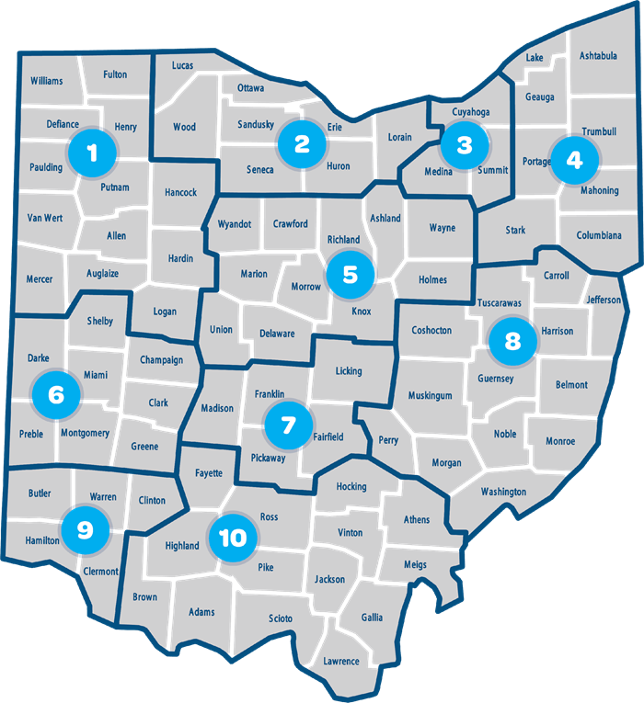
Notes:
OhioKAN is a fairly new program for ODJFS, implemented with the help of our vendor and partner, Kinnect – based out of Cleveland. In just two short years, OhioKAN has served over 3500 families.
OhioKAN is available in every part of the state and was created as a flexible and responsive program to meet the needs of kinship and adoptive families.
OhioKAN split the state into 10 regions to combine local knowledge with statewide resources. The Navigators are located within local agencies in each region. Some of these agencies may be familiar to you – Beech Acres, Village network, UMCH, and Adopt America Network, as well as county agencies- Warren County and Muskingum. To find the OhioKAN providers near you, you can go to the website and explore your region. This regional model was implemented to ensure every kinship and adoptive family who wants support is able to get it regardless of where they live.

Slide 10
OhioKAN
Kinship caregivers and post adoption families
Access by calling 1-844-OhioKAN or ohiokan.jfs.ohio.gov
Professionals can make a referral using a form on the website
Fully voluntary
Individualized referrals
Benefits coordination
Concrete supports
Notes:
OhioKAN will serve all kinship and adoption families. There is no requirement that the family is involved with children services. This may include a neighbor who suddenly had to keep children because a single mom was arrested. It could be a grandma who had an open children services case, but needed assistance after the case closed. Or it could be a family involved with children services, but the county does not have a kinship navigator. OhioKAN will work with all post adoptive families, too. Some of our families are blended with kinship and adopted children. And adoptive families can use OhioKAN to apply for PASSS funds.
The program is available voluntarily. Families can come in and out as often as they like, whenever a need is identified. And how long they work with a navigator is up to them.

Slide 11
What is KGAP?
Kinship Guardianship Assistance Program
Funding source to care for relative or non-relative children or teens
Federal, State, Connections to 21 (KGAP C21)
Notes:
KGAP stands for Kinship Guardianship Assistance Program
It is a funding program to assist relative and non-relative caregivers with financial and medical support for children or teens who are in their legal custody.
There are 3 programs:
Federal KGAP
State KGAP
Connections to 21 also known as KGAP C21

Slide 12
KGAP Overview
Combination of federal and state funds- NO LOCAL SHARE
Federal and state KGAP- hybrid programs run by PCSA and ODJFS
ODJFS will solely administer:
KGAP C21
Non-recurring expenses
Notes:
All KGAP programs are funded from a combination of state and federal funds. There is no local share, therefore PCSA’s will not be responsible for any KGAP funding. ODJFS and county PCSAs will work together to administer the federal and state KGAP programs, and you may hear us refer to those as hybrid programs because of that. ODJFS will solely administer the Connections to 21 program and the reimbursement of non-recurring KGAP expenses.

Slide 13
Child’s Eligibility
Removed voluntarily or by court
Not in best interest to stay home
Placed with kin
Certified foster parent
As foster child for 6 months
Reunification/adoption is no option
Child is US citizen / legal resident
Guardianship/custody granted in US
Strong attachment to kin caregiver
If 14 or older, consulted about KGAP
Sibling of a child with KGAP
Notes:
In order to meet the eligibility requirements for both federal and state KGAP, the child must meet the following criteria
The child must have been removed by either a voluntary placement agreement or judicial determination that states that staying in the home is not in the child’s best interests.
Remember a few minutes ago when we talked about the ability of kinship caregivers to become certified foster parents? This is where it comes into play. For KGAP, the kin caregiver must be a certified foster parent and the child must have been placed with the caregiver as a foster child for at least 6 months prior to the kinship caregiver receiving legal custody or guardianship.
Both reunification and adoption are not an appropriate option for the child.
The child must be a US citizen or legal resident, and guardianship or legal custody must be granted in the United States
The child must have a strong attachment to the kinship caregiver
If the child is aged 14 or older, they must be consulted regarding the KGAP arrangement
Any sibling of a child with a KGAP agreement who is placed with the same kinship caregiver is also eligible to enter into their own KGAP agreement, regardless of whether they were placed at the same time or if the sibling or caregiver meets other eligibility criteria.

Slide 14
Caregiver Requirements
Certified foster home
Cared for eligible child as foster parent for 6 months
Strong commitment
Entered into KGAP agreement PRIOR to guardianship/custody date
Named a primary successor guardian in KGAP agreement
Court order granting custody/ guardianship
Can be outside Ohio
Notes:
In order for the caregiver to be eligible for KGAP they must be a certified foster home who has cared for the eligible child as their foster parent for at least 6 consecutive months They must have a strong commitment to care permanently for the child. The caregiver must have entered into the KGAP agreement PRIOR to receiving guardianship or legal custody. The kinship caregiver must name a primary successor guardian in the KGAP agreement and there must be a court order granting custody/guardianship to the caregiver. These requirements apply even if the caregiver lives outside of Ohio.

Slide 15
Non-Related Caregiver Requirements
PRIOR to placement into substitute care
Existing relationship
OR
AFTER placement
Foster family has kin relationship
In home for 12 months
Foster family wants to provide permanency, not adoption
ORC 2151.4119 & 2151.4120
Notes:
For KGAP, when we say kinship that can include caregivers who are not related to the child or family in the following situations:
If the kin caregiver had a family like relationship with the child or family prior to the child entering substitute care – so think of the teacher, neighbor, coach, family friend.
Or
AFTER placement into substitute care, a court has found that the current foster family has a kin relationship with the child and does not wish to pursue adoption. Those ORC requirements further specify that the child is stable in the home with the current caregiver, has been living there for the past twelve consecutive months, the caregivers are interested in providing permanency for the child, and removing the child from the home would be detrimental to their well-being.

Slide 16
KGAP Program Differences
Federal KGAP
Federal IV-E & State GRF
Child is FCM IV-E eligible
Child is categorically eligible for Medicaid
Annual redetermination by OFC
Ends at 18 or if eligible, 21
State KGAP
Federal TANF & State GRF
Child is NOT IV-E eligible
Family is required to apply for OWF w/ Medicaid
OWF redetermination by OFA
Ends at 18 or end of HS if later, or if eligible, 21
Notes:
So let’s take a step back and compare the state and federal KGAP programs
Under the Federal KGAP program
•Funding comes from a mix of Federal IV-E dollars and State General Revenue Funds
Federal KGAP agreements are not dependent on the availability of funds
•The child must be IV-E eligible for Foster care maintenance
•The child will automatically be eligible for Medicaid as part of the federal KGAP agreement
There is an annual redetermination process for the federal KGAP program completed by our office, the Office of Families and Children.
The federal KGAP agreement will end at age 18. If the child meets the requirements listed in rule 5101:2-46-14, the federal KGAP agreement can continue until age 21, much like IV-E Adoption Assistance.
Under the State KGAP program
•Funding comes from a mix of Federal TANF (Temporary Assistance for Needy Families) and State General revenue funds
State KGAP agreements are dependent on the availability of state funds. When those funds are exhausted, the state KGAP program will close to new applications until July 1 of the following SFY
•Child is NOT eligible for IV-E Foster care maintenance under the state KGAP program
•The kinship caregiver is required to apply for Ohio Works First at their local JFS office, which will include application for Medicaid
•If the family is approved for OWF, the cash amount they receive will offset the amount of the KGAP payment so that together they equal the total KGAP agreement amount.
•If they are denied OWF, the family will still receive their full KGAP agreement amount, as the state will cover that at 100%.
•Families have 30 days after being granted legal custody to apply for OWF. If they do not apply by day 60, the KGAP agreement is terminated. It’s important to note that the family will be unable to reapply as they will no longer meet the eligibility requirement of having the agreement finalized prior to legal custody or guardianship being granted.
The only redetermination of the state KGAP program is related to OWF continued eligibility and is completed by the Office of Family Assistance.
And finally, state KGAP agreements will end when the child turns 18 unless they are still in high school. In those cases, the payments will terminate at the end of the school year. If the young adult meets the requirements listed in 5101:2-56-04 (B) the state KGAP agreement can continue until age 21. ​

Slide 17
KGAP Payments
Negotiated between ODJFS and kin caregiver
No income test/ Child’s SSI is considered
Payment is 80% of foster care per diem
Unless that amount is less than $350
Then payment would be $350 or per diem rate, whichever is lower
Notes:
Ok, so let’s talk about KGAP Payment amounts.
The payment amounts will be negotiated between our office at ODJFS and the certified kinship caregiver.
ODJFS will not consider the religion, sex, age, color, race, disability, national origin or income of the caregiver(s) when determining the KGAP payment amount.
If the child receives SSI benefits, that amount IS to be considered in the negotiation process. The kinship caregiver is to notify the social security office of the KGAP monthly amount once that has been finalized. The Social Security Administration will then offset the amount of the SSI payment by the amount of the KGAP payment.
Generally speaking, the KGAP payment will be 80% of what the foster care per diem amount is, that the kin caregiver should be receiving because they are certified and the child is placed as a foster care placement.
There are a few exceptions to this- if 80% of the foster care per diem would mean that the payment would be less than $350, then the payment amount would be either $350 or the per diem rate, whichever is lower. Let's say that again- If 80% of the foster care per diem would mean that the payment is less than $350, then the payment will be either $350 or the per diem rate- whichever is lower.
$1200 monthly foster care per diem
$960 KGAP Payment (80% of 1200)
$800 monthly foster care per diem
$640 KGAP Payment (80% of 800)
$400 monthly foster care per diem
$350 KGAP Payment (80% is $320, so payment is $350)
$300 monthly foster care per diem
$300 KGAP Payment (80% is $240, so payment is per diem rate- $300)

Slide 18
Reimbursement of Nonrecurring KGAP Expenses
Administered by ODJFS
Up to $2,000 per child
Not income based
Finalized prior to legal custody
Two years to submit docs to ODJFS
Notes:
With the implementation of KGAP comes the opportunity for kinship caregivers to be reimbursed for any non-recurring KGAP expenses. This part of the KGAP program is solely under the responsibility of ODJFS. Families apply to us for reimbursement, prior to receiving legal custody. They can get reimbursed for anything they had to purchase in order to care for the child, such as home study requirements- fire inspection, well inspection, BCI checks, a bed for the child, renovations that had to be done, attorney fees, etc. The family then has two years after receiving legal custody to provide receipts or other documentation to our office and we will reimburse the caregivers up to $2000 per child.

Slide 19
KGAP Connections to 21 (KGAP C21)
Eligibility
Federal KGAP agreement effective at age 16 or 17
Guardianship/ custody occurred at age 16 or 17
Kinship caregiver still providing support
Age 18 but not yet 21
Not married or in military
Young adult meets 1 of 5 criteria in 5101:2-55-02(A)(3)
Notes:
KGAP C21 is a financial support that can be provided to young adults who already have a federal KGAP agreement, very similar to the AAC program for adoption subsidies. KGAP C21 can begin after the young adult’s 18th birthday and continue until their 21st birthday.
Eligibility for KGAP C21 includes the following:
There was a federal KGAP agreement effective at age 16 or 17
Guardianship or legal custody occurred at age 16 or 17
The kinship caregiver is still providing support for the young adult
The young adult must be at least age 18 but not yet 21
The young adult must not be in the miliary or married
The young adult meets at least one of the 5 criteria listed in 5101:2-55-02(A)(3) (which again, are very similar to the AAC program) That rule states that the young adult
1.Is completing secondary education or a program leading to an equivalent credential;
2.Is enrolled in an institution that provides post-secondary or vocational education;
3.Is participating in a program or activity designed to promote, or remove barriers to, employment;
4.Is employed for at least eighty hours per month;
5.Is incapable of doing any of these activities due to a physical or mental condition, that is supported by regularly updated information

Slide 20
What KGAP is NOT
It is NOT for resource parents who want to adopt
It is NOT for children already in PC who are working towards an adoption
It is NOT for agencies to recommend in an effort to avoid subsidy negotiation or financial responsibility of a child in their custody
It is NOT for children or youth for whom adoption IS AN OPTION
It is NOT a way for foster parents to receive a higher monthly financial incentive than adoption
Notes:
Process slide
Also note that if the caregiver enters into a KGAP agreement and then later adopts that same child, the KGAP payments will end and the child will not be eligible for adoption subsidy either.

Slide 21
State Hearing Rights
Notes:
As an FYI- several of the kinship resources we discussed today are covered by state hearing rights. Those include KGAP, KPIP, and KSP.

Slide 22
Things to Remember
JFS 8072 ODJFS Programs Supporting Kinship Caregivers
JFS 8073 Caregiver Permanency Options
JFS 8145 Ohio Benefits Chart for Adoption/Legal Custody
Notes:
Ok , so we know we covered a lot of information in a very short amount of time today. Let’s review a few resources-
The JFS 8072, 8073, and 8145 are available on Forms Central. They will compare and contrast the kinship programs mentioned today.

Slide 24
Tara.Shook@jfs.ohio.gov
OFCTraining@jfs.ohio.gov
www.jfs.ohio.gov/ocf/training
www.odjfs.state.oh.us/forms/

Slide 25
Notes:
And finally, we want to thank you for all you do to help keep children and families safe in Ohio. Have a great weekend!

